Slide 1

Mentoring
Programme of the
Ciarb Egypt Branch

Slide 2

Branch Mentoring Programme
Fifth Cycle 2025–2026
Four Mentoring Groups mentored by experienced Mentors and dynamic Mentor Supporters guiding 22 young Mentees

Slide 3

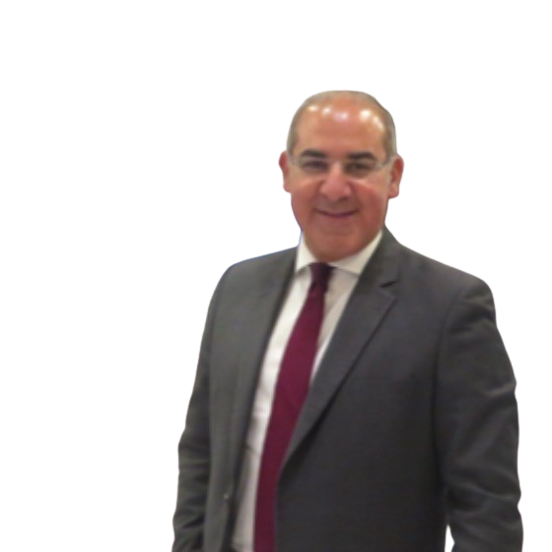
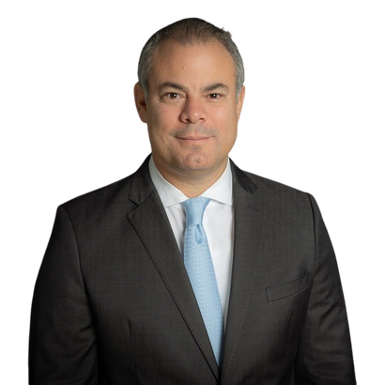
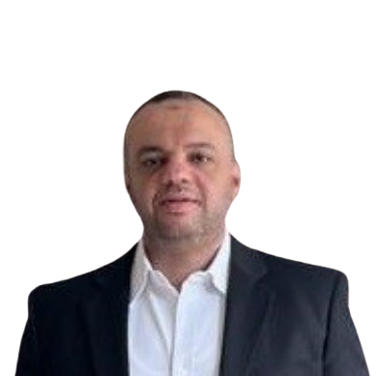
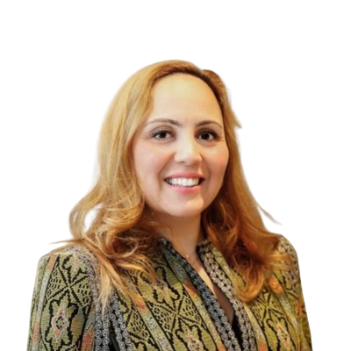
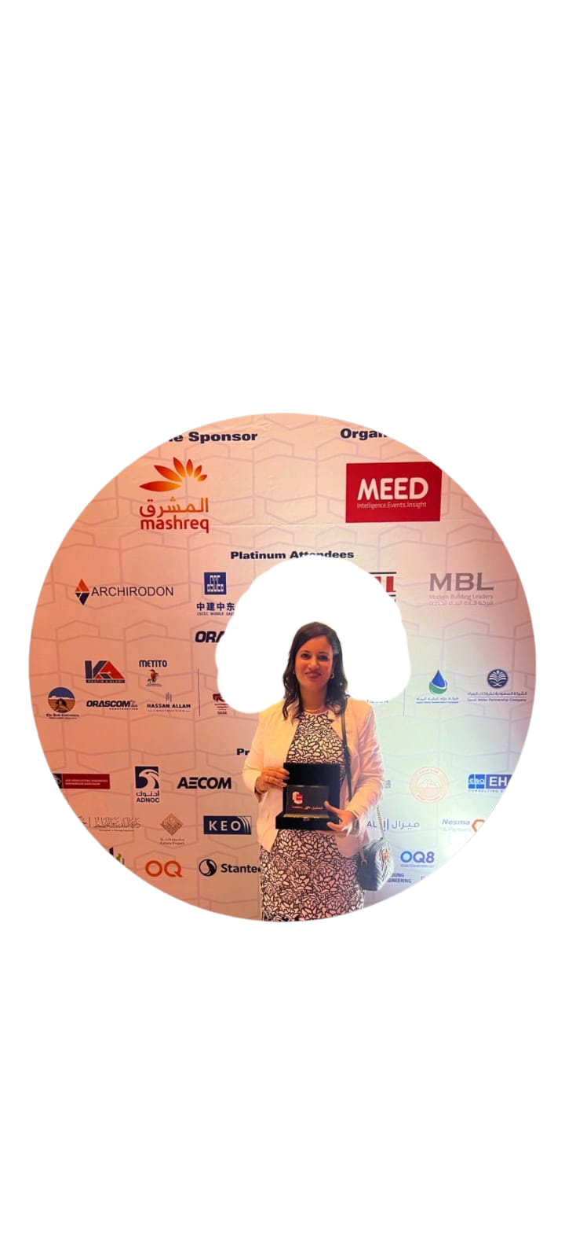
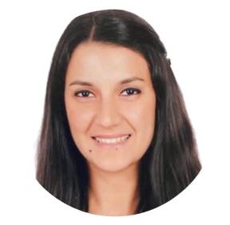
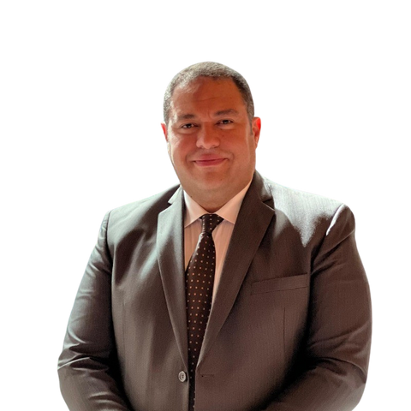
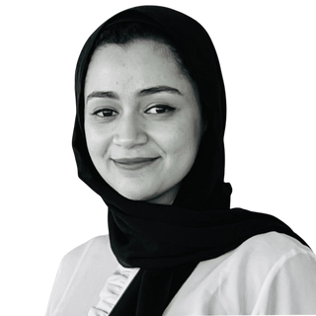
Branch Mentoring Programme
Fifth Cycle 2025 - 2026
4 Groups Mentored by:
Mentors
Dr. Khaled Attia
Mr Tarek Badawy
Dr. Ahmed Gamal
Online
Dr. Aseel Zimmo
Partner and Head of Dispute Resolution Department -Tamimi & Co.
Partner - Meysan
Contracts & Claims Manager - Rowad Modern Engineering
Independent Arbitrator and Mediator (Bahrain)
Eng. Omneya Mostafa
Eng. Sary Badawi
Online
Eng. Ola Elshamy
Mentor
Supporters
Eng. Yasmine ELKhayat
Senior Contracts Manager - Al-Futtaim
Contracts & Claims Manager -
WALY Arbitration and Contract Administration
Managing Partner -
Agile Project Management Advisors
Contracts Manager - DAMAC Properties (UAE)

Slide 4
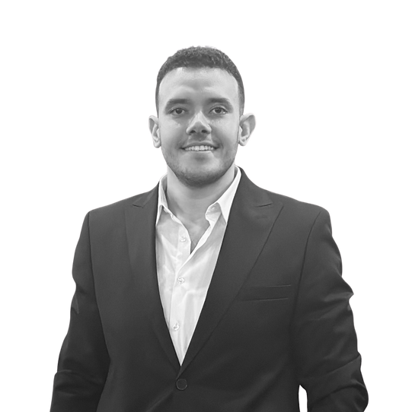
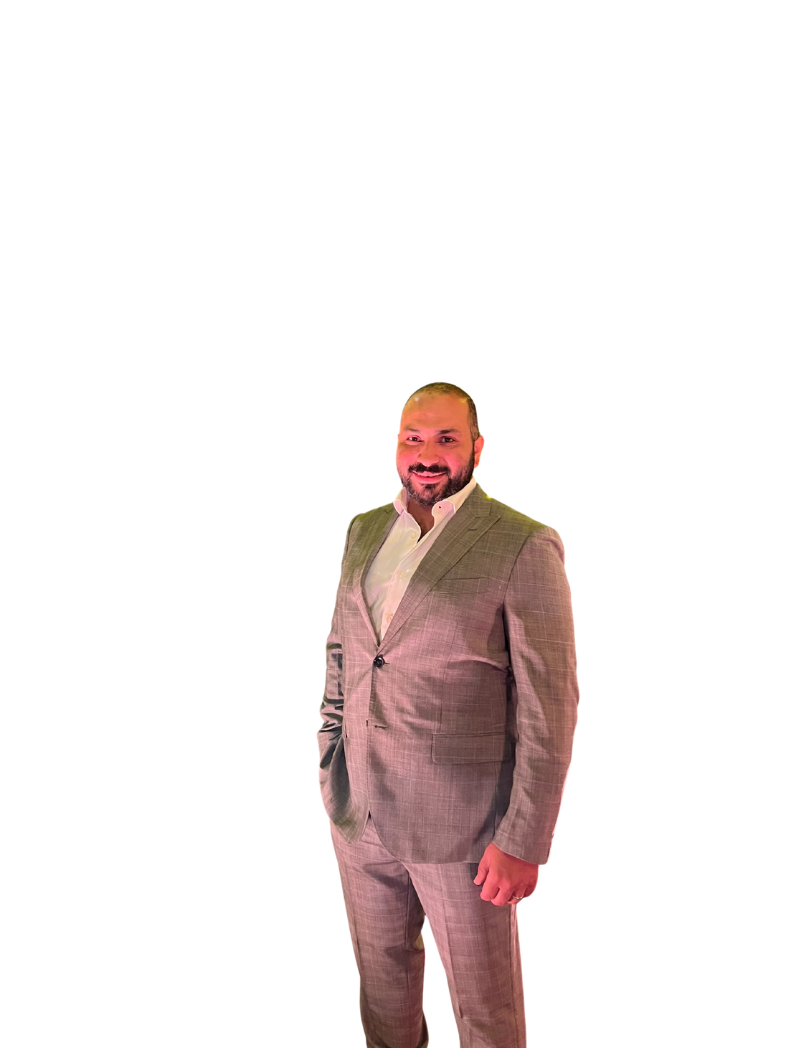
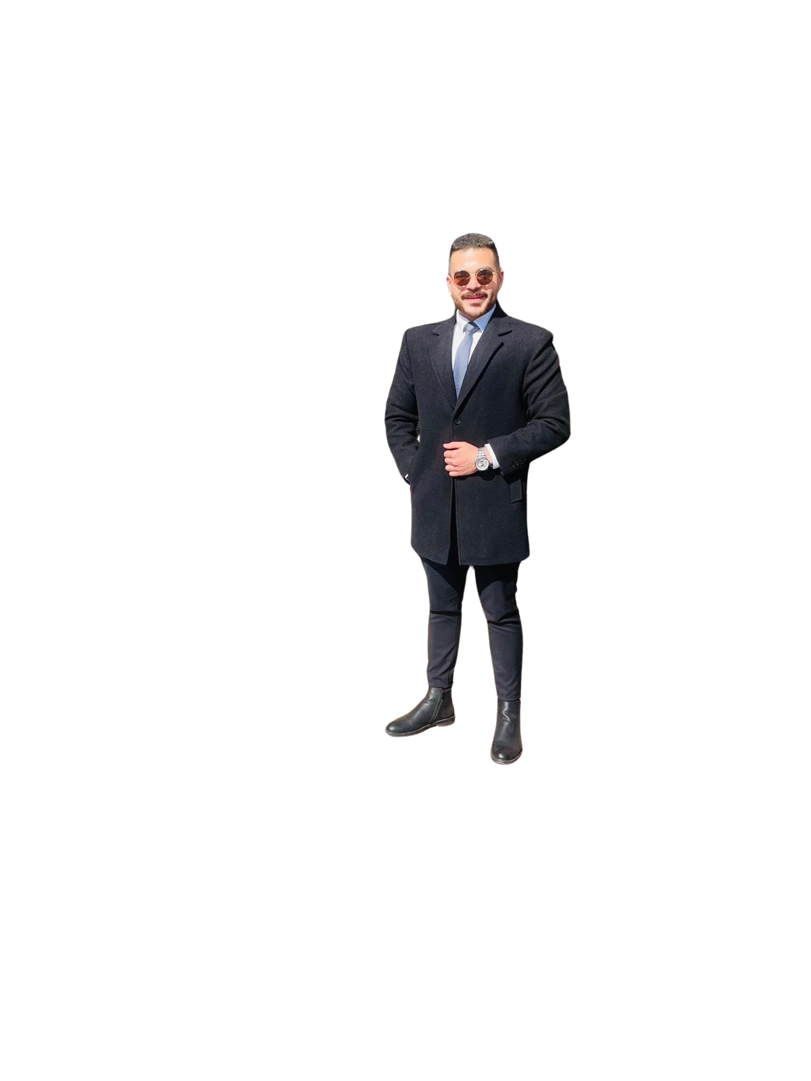
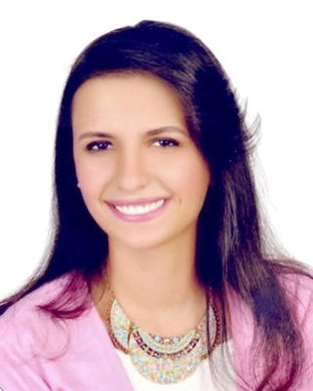
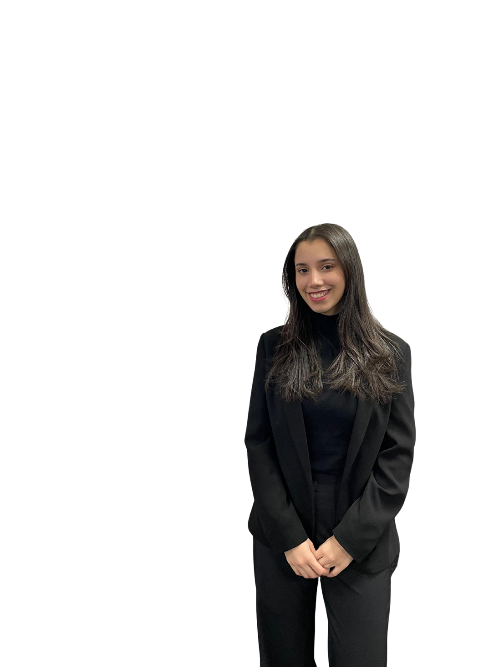
Branch Mentoring Programme
Fifth Cycle 2025 – 2026
Group 1:
Dr. Khaled Attia
Mentor
Supporter
Eng. Omneya Mostafa
Mentor
Partner and Head of Dispute Resolution Department -Tamimi & Co.
Senior Contracts Manager - Al-Futtaim
Eng. Alaa Hammad
Eng. Hussein Rasmy
Mr. Ahmed Ghalwash
Eng. Dina
Hussein
Ms. Asmaa Ahmed Kamel
Mentees
Contracts and Claims Department, Orascom Construction
Sr. Contracts and Claims Manager, LMS Construction
Corporate lawyer at Arab Organization for Industrialization
Senior Contracts Engineer; Elsewedy Electric PSP
*Ciarb Student Member - Observer

Slide 5
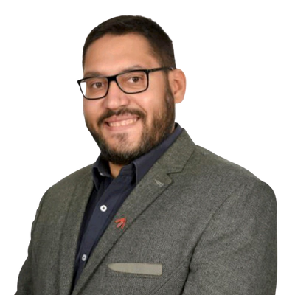
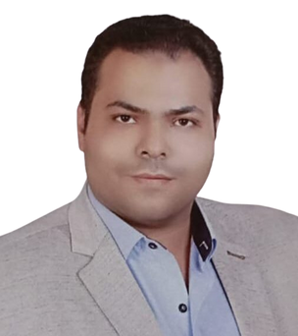
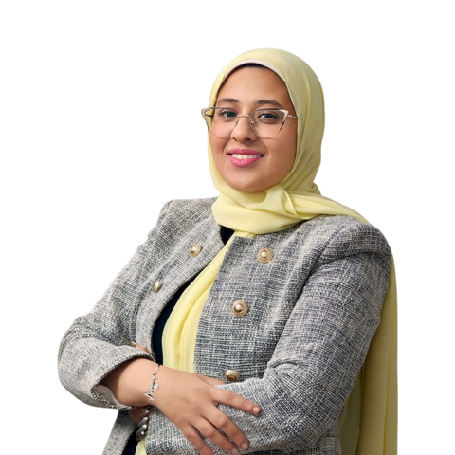


Branch Mentoring Programme
Fifth Cycle 2025 – 2026
Group 2:
Mentor
Mr Tarek Badawy
Mentor
Supporter
Eng. Yasmine ELKhayat
Partner - Meysan
Contracts & Claims Manager -
WALY Arbitration and Contract Administration
Eng. Mohamed Hanafy
Eng. Ahmed ElGuinedy
Ms. Rokaya Kamel
Mr. Mohamed Gobba
Ms. Jomana Mokhtar
Mentees
Contracts D. Manager; Madinet Masr Development
Head of Contracts, MKAN Holding
Associate - Sports Law, Corporate D
Department El Ezaby Law Firm
Researcher, Alexandria University
*Ciarb Student Member - Observer

Slide 6
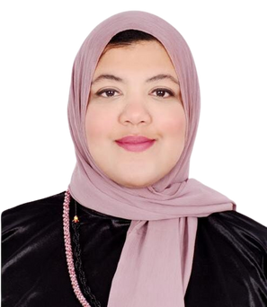
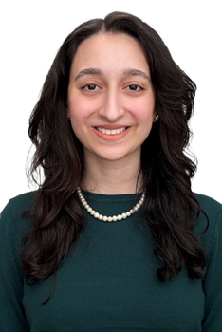
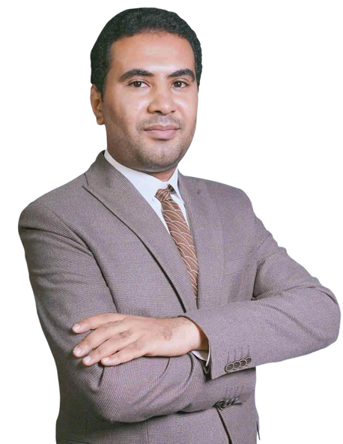
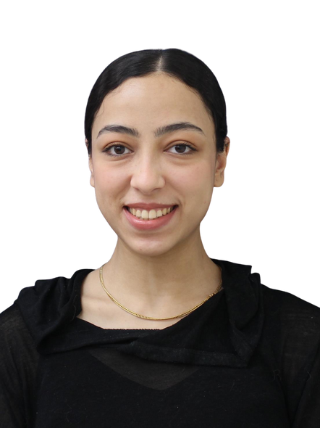
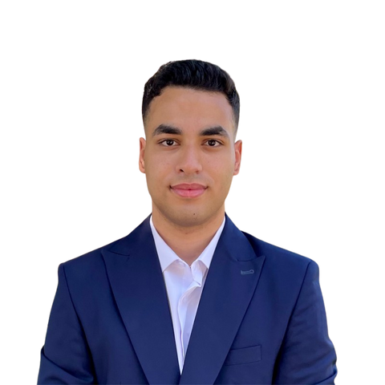
Branch Mentoring Programme
Fifth Cycle 2025 – 2026
Group 3:
Mentor
Dr. Ahmed Gamal
Mentor
Supporter
Eng. Sary Badawi
Contracts & Claims Manager - Rowad Modern Engineering
Managing Partner -
Agile Project Management Advisors
Dr. Noha Raslan
Ms. Hadil Eisawy
Coun. Abdelrahman Ali
Ms. Nagwa ElMahdy
Eng. Mohamed Khalifa
Mentees
Lecturer Assistant, Civil Engineering Department, GUC
legal Trainee at the Corporate Governance Department,
AMIC
Legal Counsel
Junior Associate, OGH Legal
*Ciarb Student Member - Observer

Slide 7




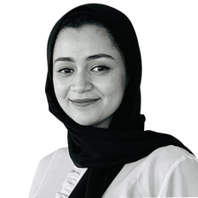
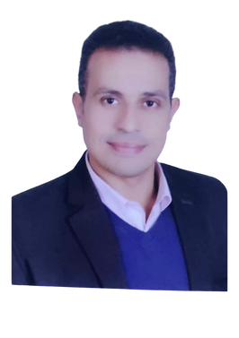
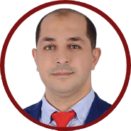
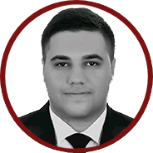
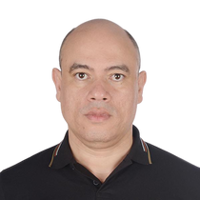
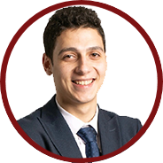
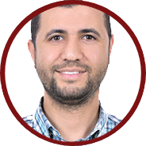
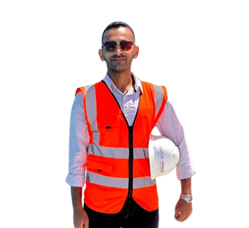

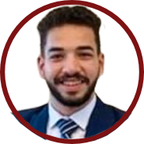
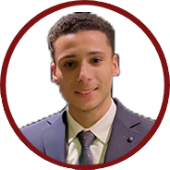
Branch Mentoring Programme Fifth Cycle 2025 – 2026
Group 4 - Online:
Dr. Aseel Zimmo
Eng. Ola Elshamy
Mentor
Mentor
Supporter
Independent Arbitrator and Mediator (Bahrain)
Contracts Manager - DAMAC Properties (UAE)
Eng. Mohamed Mohsen
Mr. Ahmed Nashaat
Eng. Mohamed Ashmawy
Eng. Mohamed Qatishat
Mentees
Contracts Manager, DAR Company, Al- Haram Expansion Project
Senior Claims Specialist, Contract & Commercial Management, Delay & Quantum Ana
Associate - Dispute resolution, Egyptian Bar Association - Local Law Office
Certified Expert Witness (RICS), Senior Commercial and Contracts Manager
Mr. Amr Sobhy
Eng.Atef Bahig
Eng. Ahmed Samir Ali
Junior Associate, the Pillar Law Firm
Senior Planning Engineer, ITALCONSULT S.P.A
Senior Contracts Engineer, Saudi Icon - Observer
Mr. Saher Bassem Lotfy
Mr. Ahmed Ramadan Moussa
LLB | Moot Court competitor | Arbitration | Ai Specialist | Vibe Coding
Ciarb Student Member - Observer

